Slide 1


Data-Driven Music Trend Analysis & Recommendation System for Spotify
Using Python and Power BI
By Charu Jain

Slide 2
Problem Statement
With the rapid growth of digital music platforms, thousands of songs are released every day. However, only a small percentage gain significant popularity, while many remain unnoticed.
Understanding what drives song popularity is crucial for improving music discovery, enhancing user engagement, and optimizing recommendation systems.
Business Objectives :
• Identify key factors influencing song popularity (streams) • Analyse the impact of playlists and cross-platform exposure • Evaluate the role of audio features in song success • Compare Spotify’s performance with other platforms • Provide actionable insights to improve trend detection and song promotion

Slide 3
Dataset Overview
The dataset consists of two primary tables containing song-level information and audio features.
1. 🎵 Song Details:
Includes metadata such as track name, artist(s), release date
Performance metrics: streams, playlists, and chart presence across platforms (Spotify, Apple, Deezer, Shazam)
Additional attributes: BPM, key, and mode
2. 📊 Audio Features (Node Data):
Contains musical characteristics of songs
Features include: danceability, energy, valence, acousticness, instrumentalness, liveness, and speechiness
Dataset Summary:
~950 songs analyzed
Multiple platforms considered for cross-platform comparison
Combines both performance metrics and audio characteristics for deeper analysis

Slide 4
Data Challenges & Preprocessing During the data preparation phase, Python is used to clean, validate, and transform the dataset to ensure accuracy and consistency.
Key Challenges:
Inconsistent Song_IDs across datasets (missing and extra keys)
Presence of duplicate records with same Song_ID but different song details
Missing values in audio features and chart-related columns
Separate columns for release year, month, and day
Handling incorrect datatype
Preprocessing Steps:
Performed data validation and resolved key mismatches before merging datasets
Handled duplicate records by identifying meaningful vs true duplicates
Managed missing values using appropriate strategies (imputation / retention based on relevance)
Combined year, month, and day into a single ‘release_date’ column
Ensured correct data types for analysis

Slide 5
Data Preparation & Feature Engineering
After cleaning the data, additional features were created to enhance analysis and extract deeper insights. These features enabled better trend analysis over time, improved interpretability of highly skewed data and allowed classification of songs into trending vs non-trending. It also help to prepared data for effective visualization in Power BI
Key Steps: • Merged Song Details and Audio Features datasets using Song_ID. • Created a unified 'release_date' column for time-based analysis. • Applied log transformation on streams (log_streams) to handle skewed distribution. • Created a 'trending' flag to classify songs based on popularity. • Ensured final dataset was structured for analysis and visualization.

Slide 6
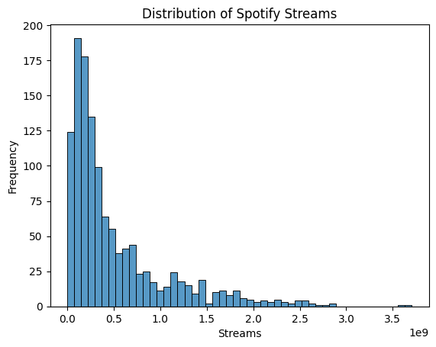
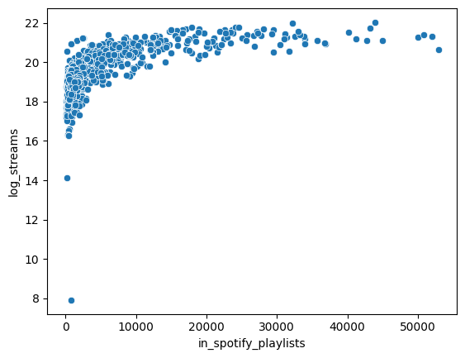
Exploratory Data Analysis
Exploratory Data Analysis was performed using Python to understand data distribution, identify patterns, and uncover initial insights.
Key Observations:
• Streams distribution was highly skewed, with a few songs having extremely high streams
• Most songs have relatively low to moderate popularity
• Playlist counts vary significantly across songs
• Audio features are distributed across a wide range, indicating diversity in music characteristics
Approach:
• Used visualizations (histograms, scatter plots) to analyze distributions
• Applied log transformation to normalize skewed data
• Explored relationships between key variables
Outcome:
• Identified imbalance in popularity distribution
• Prepared data for deeper analysis and visualization

Slide 7
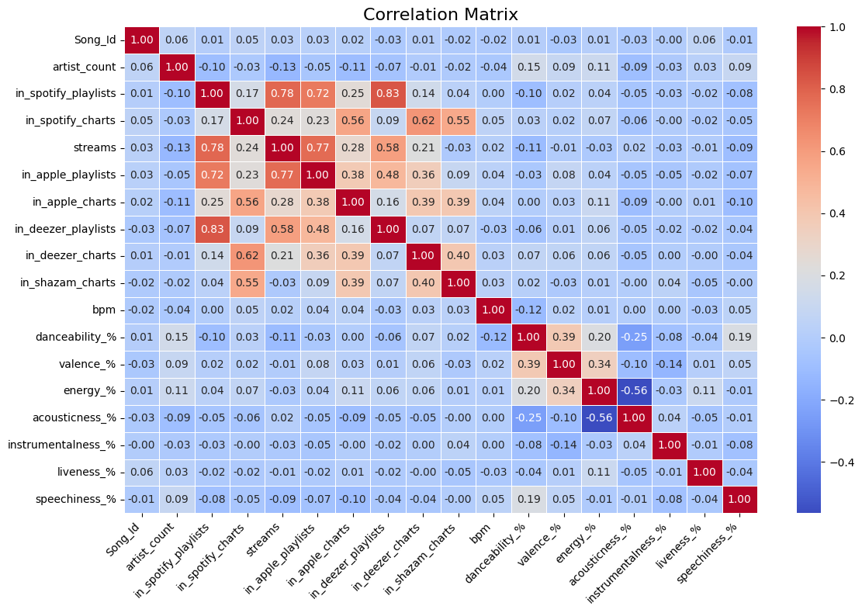
Correlation & Key Factor Analysis
Correlation analysis was performed to understand relationships between variables and identify key features influencing song popularity.
Key Findings:
• Playlist-related features show strong positive correlation with streams
• Chart presence also contributes to popularity
• Audio features (danceability, energy, etc.) show weak correlation with streams
Feature Selection Approach:
• Selected features based on correlation strength and domain understanding
• Prioritized features with higher impact on popularity
• Removed less relevant or weakly correlated variables
Selected Features for Model:
• in_spotify_playlists
• in_apple_playlists
• in_deezer_playlists
• in_spotify_charts
• in_apple_charts
• in_deezer_charts
• in_shazam_charts
• danceability_%
• energy_%
• valence_%

Slide 8
Data Scaling & Model Selection
To predict trending songs effectively, the data was scaled and a Random Forest Classifier was selected due to its ability to handle non-linear relationships, mixed feature types, and provide robust performance with minimal overfitting.
Data Scaling:
• Applied normalization (Standardization) on numerical features
• Ensured all features contribute equally to the model
• Prevented bias due to differences in feature magnitude
Model Selection:
• Problem Type: Classification (Trending vs Non-Trending)
• Used Random Forest Classifier for model training
Outcome:
• Developed a stable and efficient model pipeline for predicting song trends

Slide 9
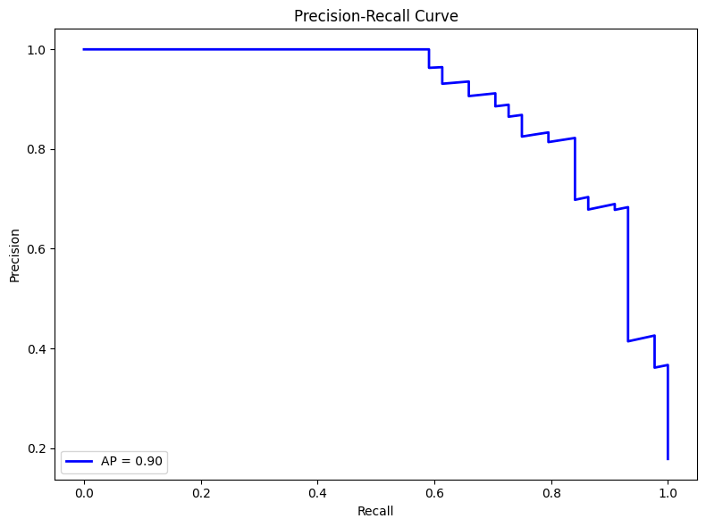
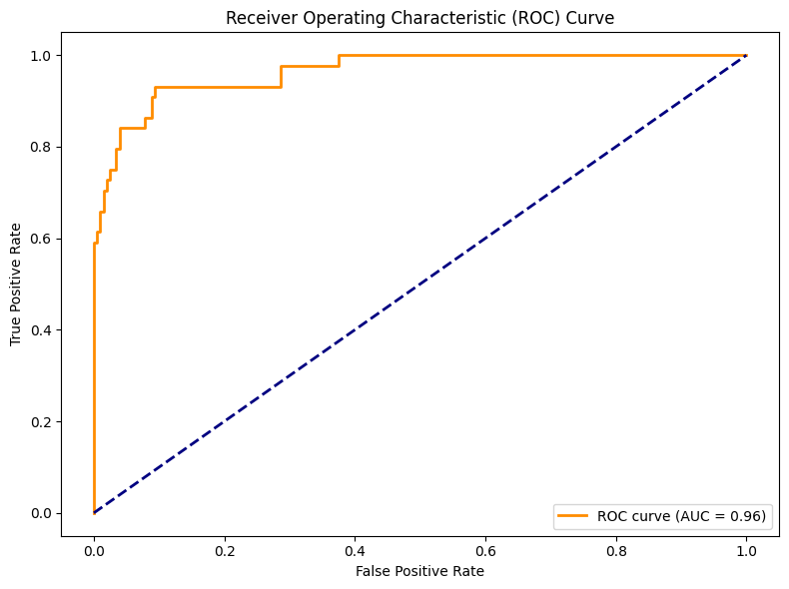
Model Evaluation & Performance Analysis
ROC Curve Analysis:
• ROC curve plotted to assess model’s ability to distinguish between classes
• High AUC value indicates strong classification performance
Precision-Recall Curve:
• Used to evaluate performance on imbalanced data
• Confirms model reliability in identifying trending songs
Final Outcome:
• Model successfully predicts probability of a song becoming trending
• Provides a data-driven approach for early trend identification
The model was evaluated using multiple performance metrics to ensure its effectiveness in predicting trending songs.
Evaluation Approach:
Split data into training and testing sets
Evaluated model performance on unseen test data
Training Accuracy: 95%
Testing Accuracy: 93.2%
Interpretation:
High accuracy indicates strong predictive capability
Gap between training and testing suggests slight overfitting
Performance Metrics:
Precision & Recall were analysed to evaluate classification performance
Ensured the model correctly identifies trending songs without excessive false predictions

Slide 10
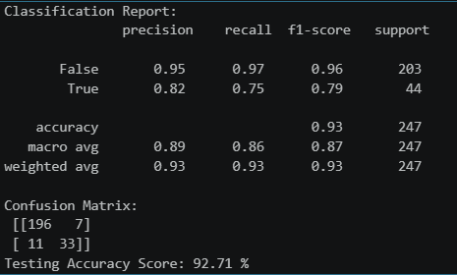
Model Evaluation & Performance
To predict trending songs effectively, the data was scaled and a Random Forest Classifier was selected due to its ability to handle non-linear relationships, mixed feature types, and provide robust performance with minimal overfitting.
Evaluation Approach:
• Split data into training and testing sets
• Evaluated performance on unseen test data
Training Accuracy: 100%
Testing Accuracy: ~92%
Interpretation:
• High accuracy indicates strong predictive capability
• Performance gap suggests presence of overfitting
Performance Metrics:
• Precision & Recall used to evaluate classification quality
• ROC Curve showed strong class separation (high AUC)
• Precision-Recall curve confirmed effectiveness on imbalanced data
Conclusion:
• Model performs well but requires optimization to improve generalization

Slide 11
Model Optimization
To address overfitting, hyperparameter tuning was applied to the Random Forest model to improve generalization. It reduce model complexity and prevent memorization of training data.
Approach:
• Adjusted key Random Forest parameters:
- max_depth - (to limit tree complexity)
- min_samples_split- (to control node splitting)
- min_samples_leaf - (to prevent overly specific patterns)
- n_estimators - (optimized number of trees)
Outcome:
• Achieved better balance between training and testing performance
• Improved model generalization and reliability
Final Result:
• Model is stable and suitable for predicting trending songs

Slide 12
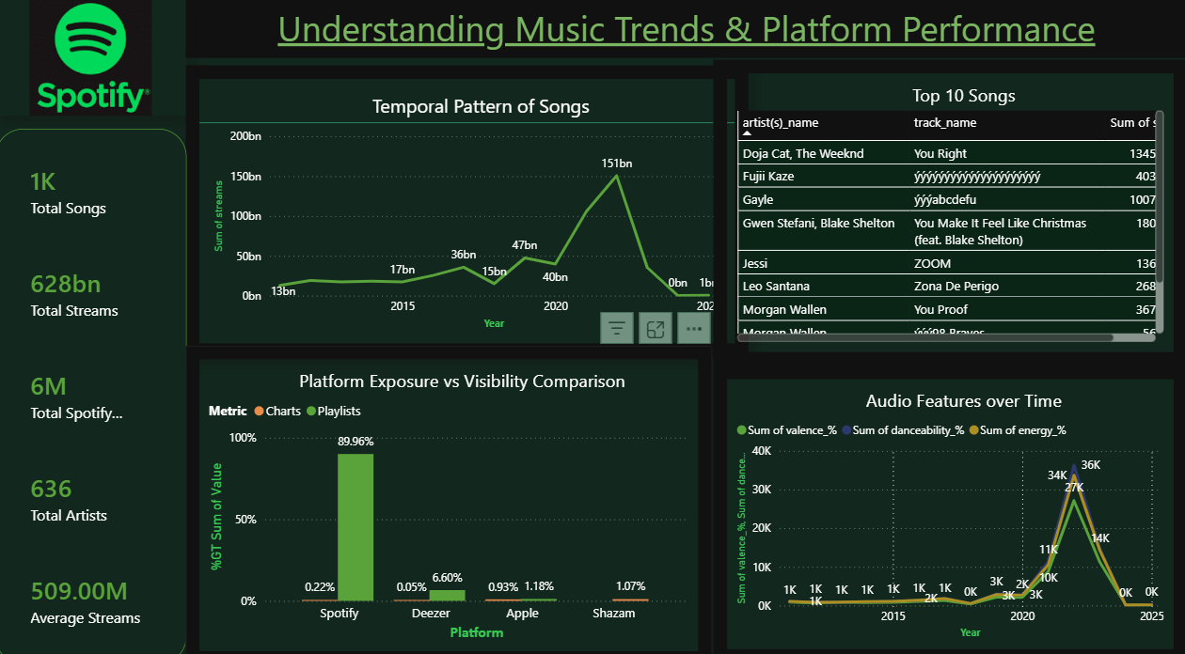
Understanding Music Trends
&
Platform Performance using PowerBI

Slide 13
Dashboard Overview
An interactive dashboard was developed using Power BI to visualize insights and support data-driven decision-making.
Purpose:
• Transform complex data into clear, actionable insights
• Enable better understanding of music trends and platform performance
Key Components:
• KPI Cards: Total Streams, Total Songs, Total Artists, Avg Streams, Total Spotify Playlist
• Popularity Analysis Table: Top songs and artists by streams
• Temporal Trends: Streaming trends over time
• Platform Comparison: Spotify vs Apple vs Deezer vs Shazam
• Feature Insights: Relationship between song attributes and popularity
Features:
• Interactive filters and slicers for dynamic analysis
• User-friendly and intuitive layout
• Designed for quick insight extraction

Slide 14
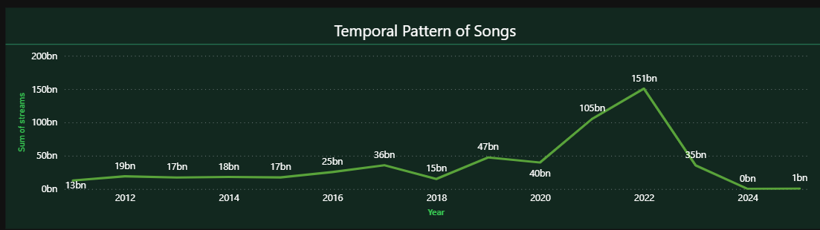
Temporal Pattern Analysis
X-axis → Year
Y-axis → Streams
X-axis → Year
Y-axis → Streams
Temporal analysis was performed to understand trends in song releases and streaming performance over time. Temporal Analysis is performed using Power BI.
Key Insights:
• Streaming trends show a consistent increase over the years
• Recent years have significantly higher total streams compared to earlier years
• Indicates growing adoption of music streaming platforms
Interpretation:
• The rise in streaming reflects increased digital consumption and platform growth
• Newer songs benefit from higher platform reach and user engagement
Conclusion:
• Time plays an important role in song performance due to platform expansion and audience growth
X-axis → Year
Y-axis → Streams

Slide 15
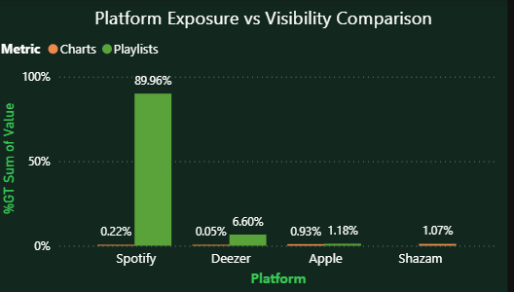
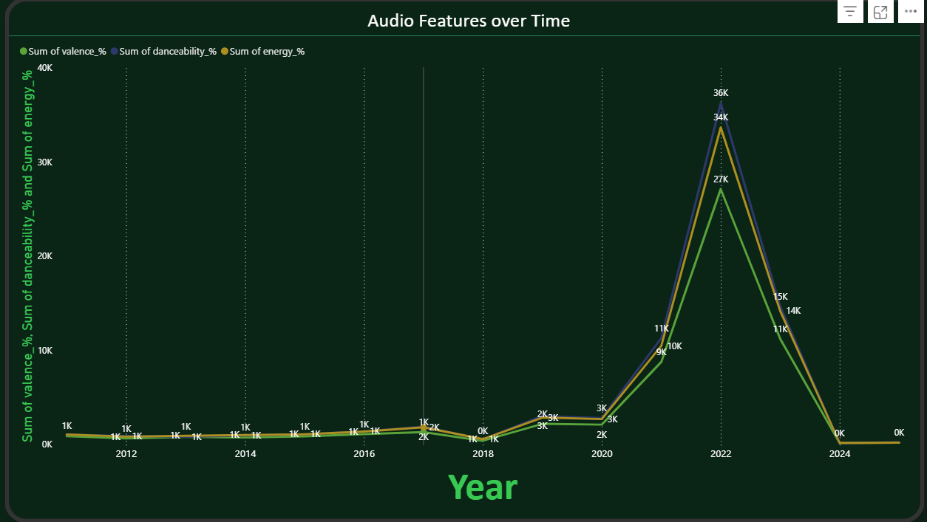
Audio Features & Platform Comparison Analysis
Audio Feature Interaction Analysis:
To understand whether musical characteristics influence song success, relationships between key audio features such as danceability and energy were analyzed.
The analysis shows that songs are distributed across a wide range of combinations, with no clear pattern linking specific feature values to higher streams.
This indicates that there is no fixed formula for creating a hit song based solely on audio attributes. While these features define the musical style, they do not directly guarantee popularity.
This highlights that external factors like playlist exposure and platform visibility play a more significant role in driving song success.
Platform Comparison Analysis:
A cross-platform comparison was performed to evaluate how songs perform across Spotify, Apple Music, Deezer, and Shazam.
The analysis reveals that Spotify leads significantly in playlist exposure, indicating a strong content distribution and recommendation system.
However, other platforms, particularly Shazam, show strong chart presence, suggesting they are more effective in identifying early trends and emerging songs.
This highlights a key gap where Spotify excels in promotion but can further improve its early trend detection capabilities.

Slide 16
Actionable Recommendations
Based on the analysis, several strategic actions can be taken to improve song discovery and platform performance.
Enhancing early trend detection should be a key focus, as identifying emerging songs at an early stage can significantly improve engagement and retention.
Integrating external signals, particularly from platforms like Shazam, can provide valuable insights into real-time user interest and help identify potential hits before they peak.
Additionally, promoting emerging songs more aggressively through dynamic playlist updates can increase visibility and improve their chances of becoming popular.
These actions can help strengthen Spotify’s recommendation system and improve its ability to identify and promote trending music effectively.

Slide 17

Thank you
This project helps to analysed song performance data to identify the key factors influencing music popularity. The findings highlight that playlist exposure and platform visibility play a more significant role than audio features in driving success. Additionally, cross-platform insights revealed opportunities to improve early trend detection. By combining data analysis, machine learning, and interactive visualization, the project provides a comprehensive, data-driven approach to understanding and predicting song trends. These insights can support better decision-making, enhance recommendation systems, and improve music discovery strategies.

Slide 18
Thank you
This project successfully analyzed song performance data to identify the key factors influencing music popularity. The findings highlight that playlist exposure and platform visibility play a more significant role than audio features in driving success. Additionally, cross-platform insights revealed opportunities to improve early trend detection. By combining data analysis, machine learning, and interactive visualization, the project provides a comprehensive, data-driven approach to understanding and predicting song trends. These insights can support better decision-making, enhance recommendation systems, and improve music discovery strategies.

